Slide 1
ArcGIS Pro Essentials
Basics of ArcGIS from Desktop Tutorials. MUST be viewed as a slideshow to see the process flow. Run it Auto or with the timings turned off. (Slide Show | Use Timings)
Ref: http://learn.arcgis.com/en/projects/get-started-with-arcgis-pro/
ACKNOWLEDGEMENT
This presentation is derived from the above page, with navigation and explanations added to simplify the learning process. While the presentation in its entirety remains the property of NCI, the knowledge base and some graphics in the above URL are owned by ESRI
Copyright © 2019 by National Computational Infrastructure, Canberra, ACT, Australia. Author: Dr. Arapaut V Sivaprasad.
10 January, 2018

Slide 2
SUMMARY
In this tutorial we address the following:
Introduction to ArcGIS Pro and Technical Specifications.
Install and configure a desktop version.
Use ArcGIS Pro as a GSKY client.
Advanced usage of ArcGIS Pro.
NOTE:
This slide show is a quick way to learn the basic usage of ArcGIS Pro in relation to using it as a GSKY client. The intention is to reduce the learning time from several hours to a few minutes, but it will not make you an expert in the use of ArcGIS Pro or GSKY through ArcGIS Pro. For those who wish to learn deeper, see the Word/PDF documents that give both pictorial and textual description of all that in this slide show and more.
Slides 3 - 9 describe the use of ArcGIS Pro as GSKY client.
Slides 10 - 18 describe the advanced usage of ArcGIS Pro.
Animated slides that follow will describe the usage stop-by-step. It is important to run as a slideshow to see the full picture.
Slide show will start in 5 sec.

Slide 3

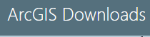
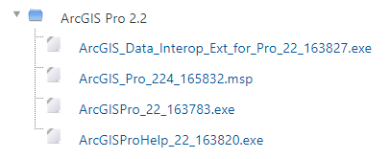
Introduction to ArcGIS Pro
ArcGIS Pro terminology
Project —A collection of related GIS resources such as maps, scenes, layouts, datasets, tools, connections, and tasks. Most project items are stored in the project file (.aprx). Every project has an associated geodatabase (.gdb) and toolbox (.tbx). These are stored externally to the project file but typically in the same system folder.
View—A window containing a presentation of data such as a map, layout, or table. The active view is the primary work area of the application.
Map —A project item used to display and work with geographic data in two dimensions.
Scene —A project item used to display and work with geographic data in 3D. Scenes can be viewed in global mode (for large geographic areas) or local mode (for small geographic areas).
Basemap —A layer of background reference information, such as topography or imagery, on which other thematic layers are displayed.
Layer —A representation in a map or scene of a collection of geographic features that are usually of the same thematic type, such as cities, parks, or roads. Some layers represent measured or remotely-sensed properties of surfaces, such as elevation, temperature, or land cover.
Geoprocessing —A framework and set of tools for analyzing, manipulating, and managing geographic data.
Task —A set of steps that guide you through an ArcGIS Pro workflow.
Layout —A collection of map elements organized on a virtual page designed for printing.
Portal—A connection to ArcGIS Online or ArcGIS Enterprise. In ArcGIS Pro, you sign in to a portal to share your work and access content shared by others.
ArcGIS Pro 2.3.0 is the latest professional desktop GIS software from Esri. With ArcGIS Pro, you can view, explore, analyze, edit, and share your maps and data. An ArcGIS Pro project can contain many maps and layouts as well as tables, charts, and other items. 3D capabilities are native to ArcGIS Pro; any 2D map can be converted to a 3D scene. The sections below introduce basic elements of the user interface and important terms. You will build on this knowledge as you use the application, read the help, and complete tutorials. [^{Ref}]
In this tutorial we plan to explore the installation of ArcGIS Pro 2.3.x, its basic usage and its use as a GSKY client. ArcGIS Pro is a Windows-only software. There is an ArcGIS Online version that is platform-independent.
Installation
Browse to the ArcGIS Wattle Course, and log in with your ANU UniID.
Next: Installation

Slide 4
Installation
Installing ArcGIS Pro on your ANU Desktop [^{Ref}]
This is the recommended way for installing ArcGIS Pro on to your computer.
Important Note: You will need Administrative Privileges to install the software on your computer.
Note: Make sure that you have deactivated and uninstalled any other version of ArcGIS Pro installed on your computer.
1) Extract the installers by either running the exe's, or use a program like 7-Zip to manually extract them. 2) You will need to install DotNet 4.5 onto your computer - Open 'Programs and Features' from the Control Panel - Click 'Turn Windows Features on or off' from the sidebar For Windows 8 and newer: - Tick '.NET Framework 4.x' (ie '.NET Framework 4.6 (Advanced Services)')
For Windows 7: - Download .NET Framework 4.5 or above and follow the 'Install Instructions' listed.
3) Run the ArcGISPro.msi in the ArcGISPro Folder and follow the prompts: eg: <Extracted Path>\ArcGISPro_2x_yyyyyy\ArcGISPro\ArcGISPro.msi
4) Run the ArcGISProHelp.msi in the ArcGISProHelp Folder and follow the prompts: eg: <Extracted Path>\ArcGISProHelp_2x_yyyyyy\ArcGISProHelp\ArcGISProHelp.msi
5) Run the DataInteropPro.msi in the ArcGISProDataInterop Folder and follow the prompts: eg: <Extracted Path>\ArcGIS_Data_Interop_Ext_for_Pro_2x_yyyyyy\ArcGISProDataInterop\DataInteropPro.msi
6) Run the ArcGIS_Pro_<version>.msp to install the latest Patch, follow the prompts. 7) If you are on campus follow the instructions on the Activating ArcGIS Pro on an ANU desktop computer page, otherwise follow the instructions on the Activating ArcGIS Pro on a laptop page.
NOTE:
The installation and activation instructions given here are specifically for the ANU staff and students. You will have to follow the instructions for your own organisation and/or get a paid licence from ArcGIS directly.
Next: Activating the Licence

Slide 5

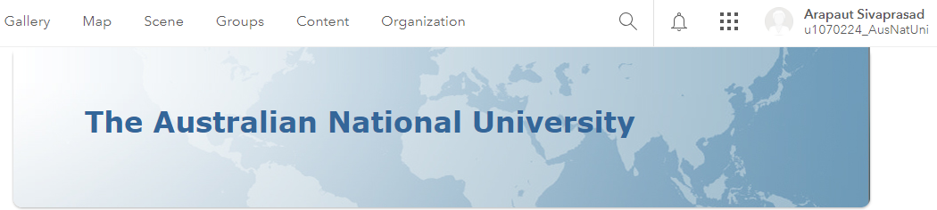
Activating the Licence
Activating ArcGIS Pro on a laptop [^{Ref}]
If your computer is on the ANU Network follow the instructions on the 'Activating ArcGIS Pro on an ANU desktop computer' page.
Otherwise if you require access to ArcGIS Desktop from a computer that is not on the ANU Network or you would like to use it on a home computer, you can request a Standalone License.
Requesting an ArcGIS Standalone License
Standalone Licenses will only be supplied to a current Staff/Student with a valid ANU email address and is vaild until the Janurary of the next year.
Note: ArcGIS must be uninstalled/removed from your computer upon leaving the University.
Once you have set up your ArcGIS Online account, you can request an ArcGIS Pro Standalone license.
user_ID
Next: Continued…

Slide 6
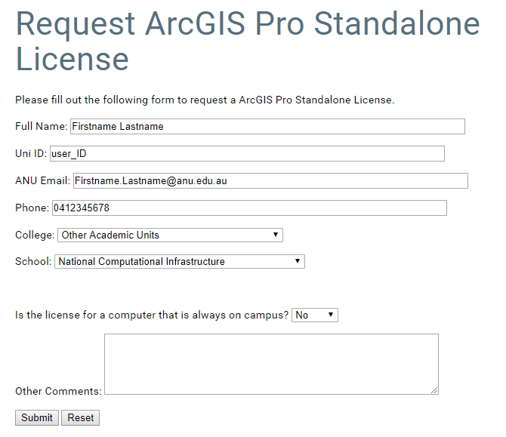
Activating the Licence
Activating ArcGIS Pro on a laptop [^{Ref}]
You can request an ArcGIS Pro Standalone license here.
Activating the ArcGIS Pro Standalone License
Once you have received confirmation that your your ArcGIS Online account is authorized offsite use, you can activate it using the following steps.
Note: You may need to follow this instructions as the user who will use ArcGIS Pro. 1) Open 'ArcGIS Pro' from the start menu 2) Login using your ArcGIS Online account.
Next: Start a Project and Configure

Slide 7
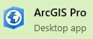

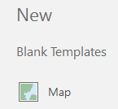
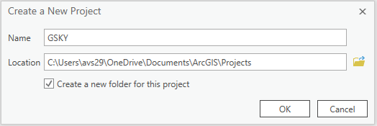
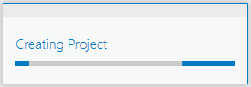
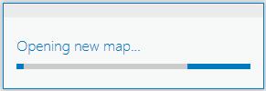
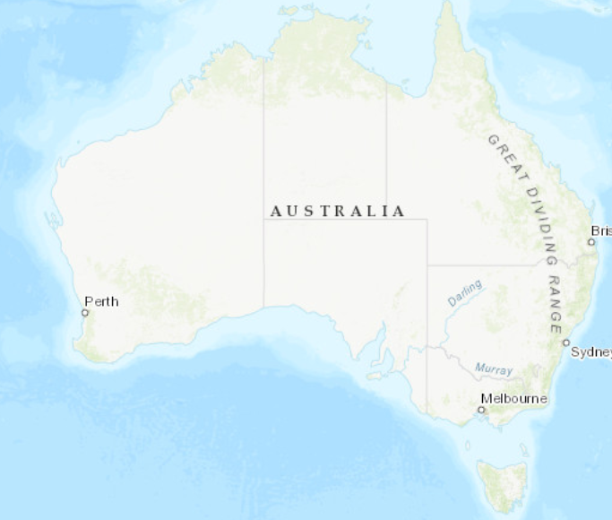
Start a Project
Next: Configure CRS

Slide 8
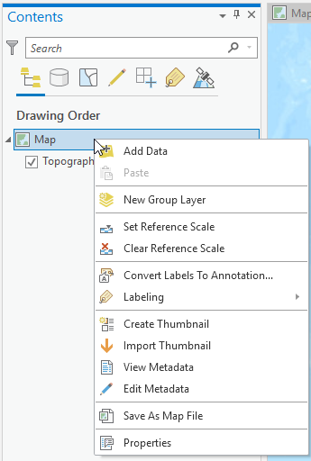
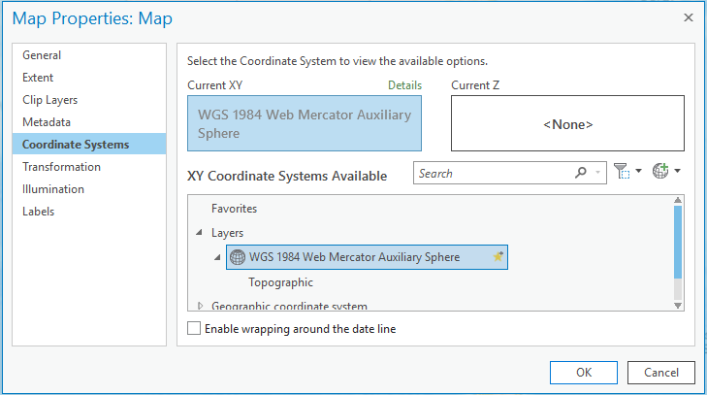
Configure CRS
EPSG:4326 is used as default by ArcGIS Pro. For GSKY it is necessary to use EPSG:3857. This configuration is critical to avoid errors when displaying GSKY datasets.
Next: Add GSKY Web Map Service

Slide 9
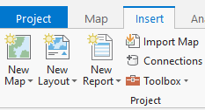
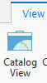
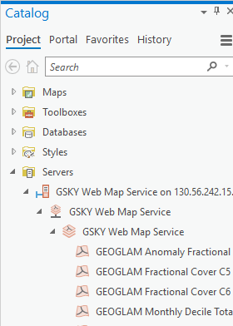
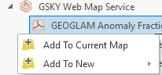
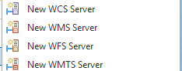
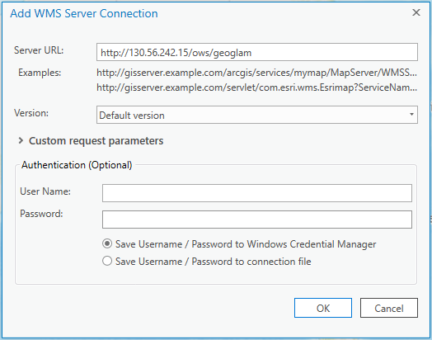
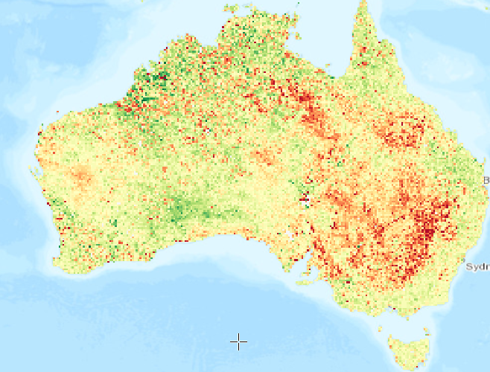
Add GSKY Web Map Service
NOTE: The CRS reverts to EPSG:4326 everytime a new GSKY layer is added. Hence, it is important to set the CRS to EPSG:3857 after each new addition.
Next: Advanced Usage of ArcGIS Pro

Slide 10
Advanced Use of ArcGIS Pro
Though currently not relevant to the GSKY services, ArcGIS Pro has many features and configurations to anlayse datasets. A few of these will be demonstrated in the tutorial section that follows.
The tutorial is adapted from http://learn.arcgis.com/en/projects/get-started-with-arcgis-pro/
Text-based tutorial at the above site, which takes 3 hours to go through, has been abridged into a 10 minute presentation. While it will give an overview of the process, see the above page to learn the details.
Builds skills in
Imagery & Remote Sensing
Mapping & Visualization
Spatial Analytics
Next: Start Tutorial

Slide 11
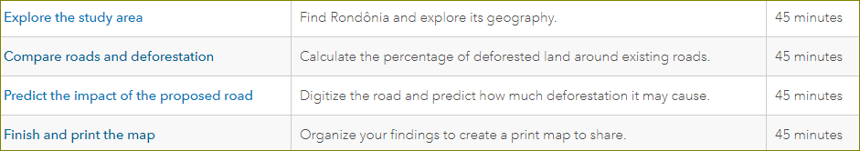
Lesson Plan
In this lesson, you'll use ArcMap to create a map of deforestation in the Brazilian state of Rondônia. Then, you'll predict how much deforestation would be caused by a road proposed to be built across the state. Your workflow requires a wide variety of data, feature editing, and analysis tools. You'll also learn how to share your results as an informative print map.
DISCLAIMER
This presentation is an animated flow of the steps in the four lessons listed above. It covers the process in about 10 minutes as compared to 3 hours by the lessons. However, it may not be an alternative to going through the lessons. Not every step is included in this animated presentation. The way to get the best outcome is to study both. Textual instructions in the lessons are easier to understand if you run this presentation at least once.
The copyright of this presentation is with NCI, whereas the knowledge base and some graphics are the property of ESRI.

Slide 12
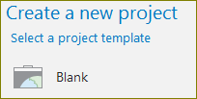
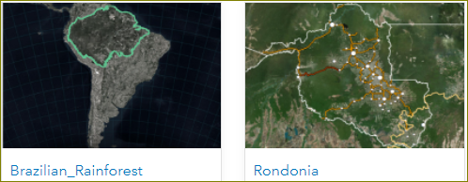
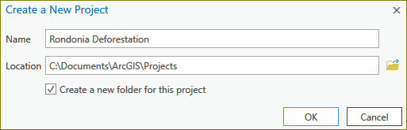
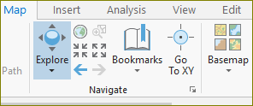


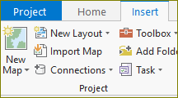
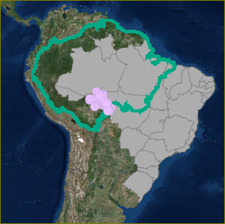
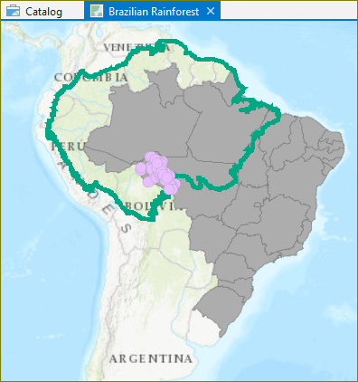
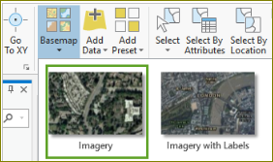
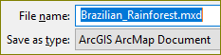
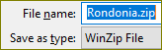
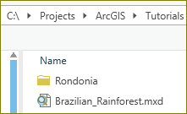
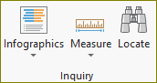
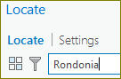
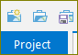
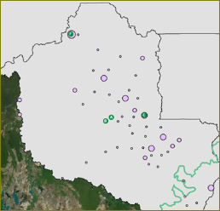
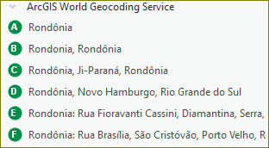
Explore the study area
Before you can make a map, you must first create a project. A project stores the maps, databases, toolboxes, styles, and other folders that may be useful when making your map. Then you'll import a map document with some of the data you need to start the map.
1. Go to the Get Started with ArcGIS Pro group.
2. Download and save the Brazilian_Rainforest.mxd file.
3. Download and save the Rondonia.zip file.
4. Open ‘Start | ArcGIS Pro’ desktop program.
5. Start a new project, ‘Rondonia Deforestation.aprx’
6. Import a map
7. Change the base map
8. Locate ‘Rondonia’
9. Save the project.
Next: Organise and symbolise data

Slide 13
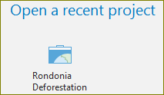
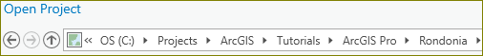
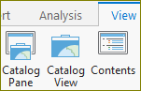
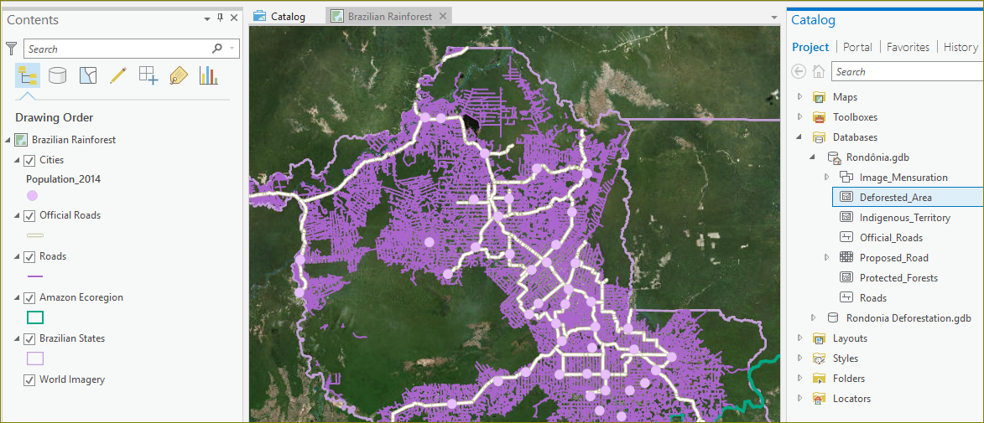
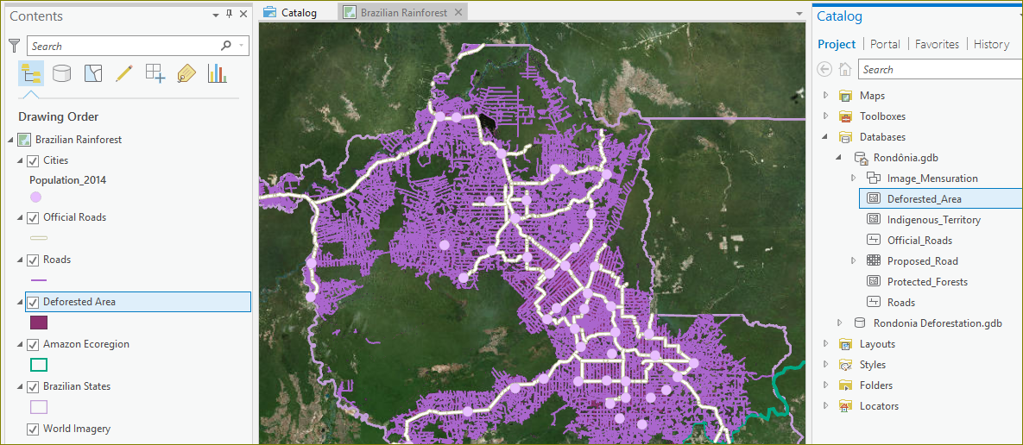
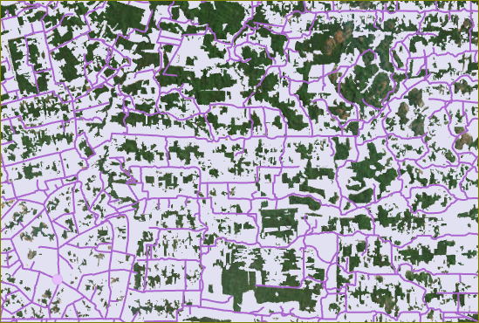
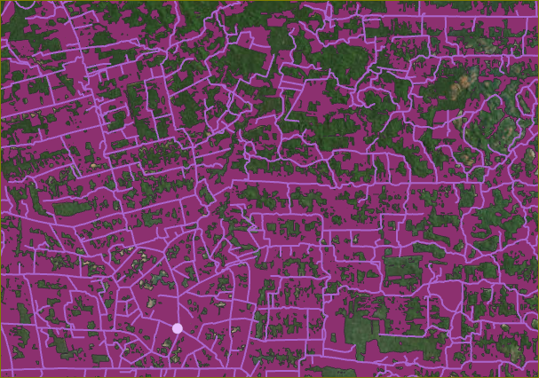
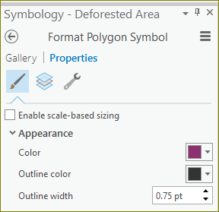
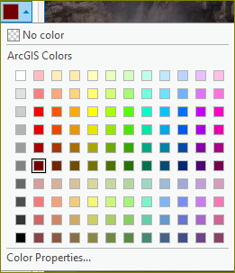
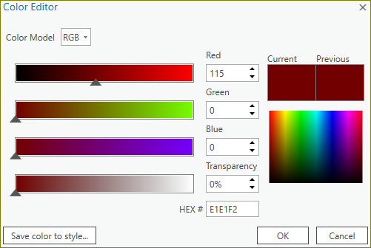
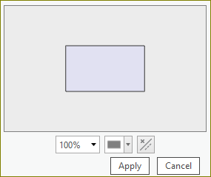
Explore Deforestation
Although you looked at deforestation in the last lesson, now you'll begin a more thorough exploration to understand existing deforestation patterns in Rondônia. You'll start by adding a layer that shows deforestation in the state.
OR
Deforested_Area
1. Open the Amazon Deforestation project in ArcGIS Pro.
2. Expand Catalog | Databases and drag ‘Deforested_Area’ to contents.
3. Change the color of the deforested areas.
Next: Protected Forests

Slide 14
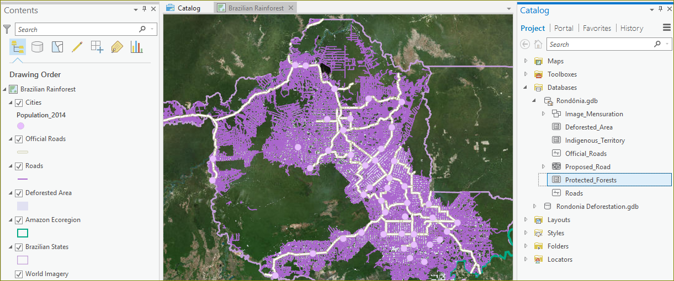
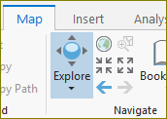
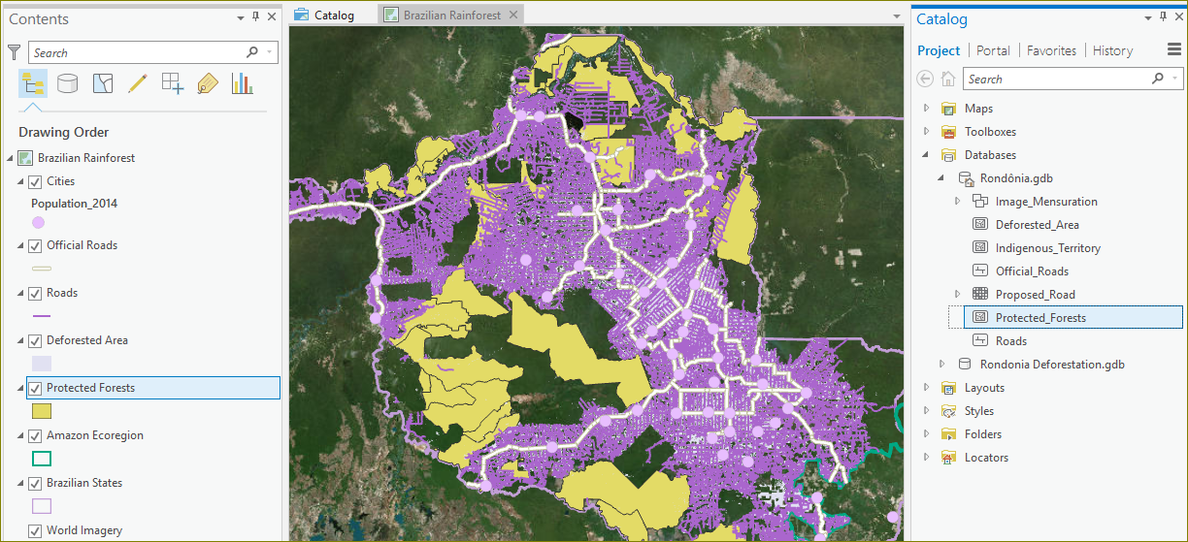


Protected Forests
Protected areas come in two types: protected forests and indigenous territory. Feature classes for both categories are in the Project Data geodatabase. You can add both to explore, but for this project you only need the data on protected forests.
Protected_Forests
1. Expand Catalog | Databases and drag ‘Protected_Forests’ to contents.
2. Zoom to inspect closely.
3. Click on ‘Explore’ and then Shift-drag to draw a rectangle. Repeat.
Next: Deforestation near roads

Slide 15













Deforestation near roads
Your goal is to estimate how much deforestation a proposed road would cause if its construction were allowed. To make this estimate, you'll first find how much deforestation is associated with existing roads.
1. Display the map with all layers turned on.
2. Turn off all layers except Roads and World Imagery.
3. Choose the ‘Map | Select | Rectangle’ and draw a small area to select.
4. Click ‘Map | Explore’ and then zoom to show the details.
5. Click ‘Analysis | Tools | Buffer’, select/input the params and press ‘Run’.
6. Clear the selected roads by clicking ‘Clear’ under ‘Map | Selection group’.
7. Click the back arrow on Geoprocessing, type in Clip and choose Clip tool.
8. Select/enter the params for Clip and Run the tool.
Next: Percentage Deforestation

Slide 16






Percentage deforestation near roads
You've created two layers. One shows the area within 5.5 kilometers of the roads in your sample area. The other shows deforestation within that buffer. Your next goal is to calculate the percentage of the buffer that is deforested. To find the percentage, you'll calculate a new attribute field.
1. Right click ‘Contents | Deforestation_Clip’ and choose ‘Attribute Table’
2. Copy the value under ‘Shape_Area’ and save in clipboard or in a scratch pad.
3. Right click ‘Contents | Roads_Buffer’ and choose ‘Attribute Table’.
4. Click on ‘Field: Add Field’
5. Enter/select Field Name, Alias and Data Type.
Next: Continued…
6. Click ‘Save’ on the ‘Fields’ tab.

Slide 17



Percentage deforestation near roads. Cont.
7. In the Roads_Buffer table, right-click Percent Deforested and choose Calculate Field.
8. Type in the ‘Percentage_Deforested = ’ field the Shape_Area value saved from step 2 and then…
- Type /
- Click ‘Shape_Area’
- Type * 100
9. Click ‘Run’ and look under ‘Roads_Buffer’ table for the ‘Percent Deforested’ value.
Next: Using as a GSKY Client

Slide 18






















Using as a GSKY Client
This section describes the use of ArcGIS Pro as a GSKY client, much like TerriaMap is used as GSKY client. Not all functionalities of TerriaMap will be available and there are some errors not seen with TerriaMap. These errors are explained and suggestions to avoid them are given.
1. Run the application as ‘Start | ArcGIS Pro’
2. Click ‘Blank’ to start a new project or select an existing project.
3. Give the new project a name and storage location.
4. Under ‘Projects | Insert’ tab click on ‘New Map’, ‘New Global Scene’ or ‘New Local Scene’
5. Add the GSKY server via ‘Projects | Insert | Connections | New WMS Server’
6. Click ‘Catalog | Contents | Servers’
7. Double-click ‘GSKY Web Map Service on …’
- Repeat until the layers become visible.
8. Right-click the required layer and select ‘Add to Map’
9. Zoom and/or pan.
Errors
Zooming and panning may lose the layers.
The picture quality is low.
Cccasionally hangs the GSKY server.
End of Slides

Slide 19
Title
Next:

Slide 20
Title
Next:

Slide 21
Title
Next:

Slide 22






Acknowledgements

